Slide 1
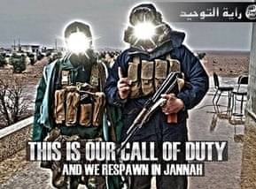
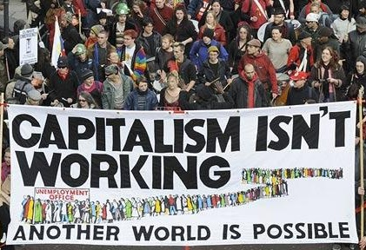

1
Starter: Extreme propaganda
Propaganda
Information or images designed to influence a person’s opinion.
Pair task (2-3 mins)
Have a look at some of this extremist propaganda. What strategies are they using to promote their cause? Hint: how are they trying to make the reader feel?
Making their cause seem brave or exciting
One strategy is creating stories to prove their cause is justified and heroic.
They may also create narratives which present “different” groups as the enemy.
Promising solutions or a better life
Creating a feeling of belonging and identity
Blaming certain groups for problems
Notes:
Images:
https://www.adl.org/education/resources/tools-and-strategies/table-talk/propaganda-extremism-online-recruitment
https://edition.cnn.com/2019/08/19/opinions/portland-protest-antifa-proud-boys-opinion-obeidallah/index.html
https://www.theguardian.com/world/2014/jun/23/who-behind-isis-propaganda-operation-Iraq
https://commons.wikimedia.org/wiki/File:%22Freedom_go_to_hell%22.jpg
https://southdakotapolitics.blogs.com/south_dakota_politics/2009/04/obama-no-good-very-bad-day-in-london.html

Slide 2

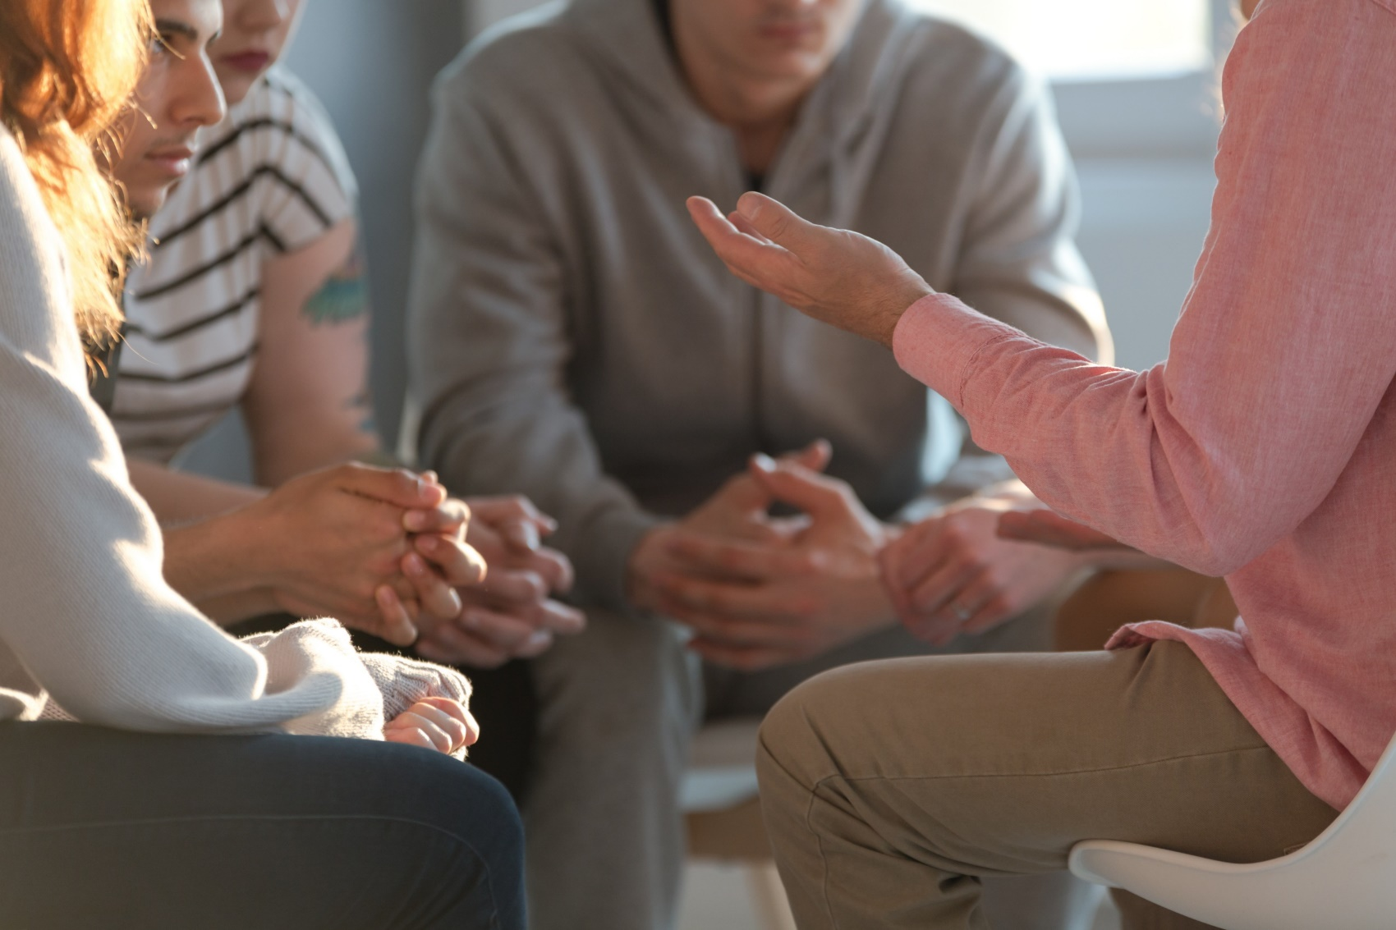


Can sharing stories prevent extremism?
If you are concerned by any of the issues raised in this lesson, click on the Let’s Talk About It website logo to find out about how they can help. Also, see the final slide for some more advice on who to talk to.
Notes:
References
https://www.ltai.info/
Images:
iStock

Slide 3
To understand the narrative told by extremists group.
To consider whether sharing stories might help prevent extremism.
Extremism: Having views that might seem unreasonable or unacceptable to most people.
Radicalise: to make someone become more extreme in their beliefs.
Prevent: to stop something from happening.
Notes:
References
https://dictionary.cambridge.org/dictionary/english/

Slide 4

Starter: Extreme propaganda
Why are we talking about this?
Real-life consequences
The other side of the story
Why share these stories?

Slide 5

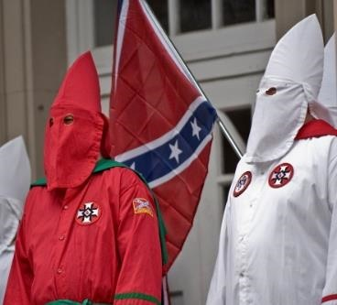
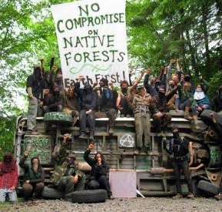
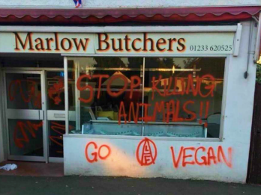
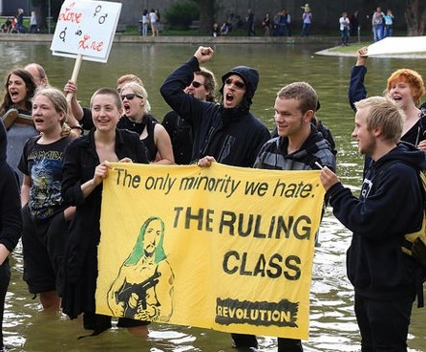
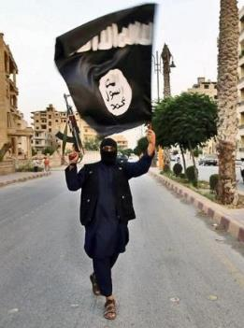
2
Why are we talking about this?
Discuss (1 min)
What do you think an extremist is?
An extremist strongly supports a certain idea or cause in a way that most people find unreasonable. They may use these views to justify hateful or harmful behaviour towards those they oppose or who oppose them.
Religion
Different extremists groups could target anything. They may dislike certain people because of their opinions, lifestyle, identity or culture.
Politics
Race
They will look out for vulnerable people who they can persuade to agree with their extremist views.
Gender
Notes:
Images:
https://foreignpolicy.com/2017/09/01/the-green-radicals-are-coming-environmental-extremism/
https://www.ft.com/content/bde61e42-9243-11e7-a9e6-11d2f0ebb7f0
https://www.breitbart.com/europe/2018/05/28/vegan-activists-threaten-fire-bomb-butchers-animal-rights-attacks-rise/
https://www.flickr.com/photos/arete13/4126186099
https://www.haikudeck.com/title-uncategorized-presentation-tRjFKPce3j
https://www.exberliner.com/features/opinion/could-you-be-a-left-wing-extremist/
iStock
References:
https://educateagainsthate.com/school-leaders/define-extremism-terrorism-uk-2/
https://www.ltai.info/

Slide 6
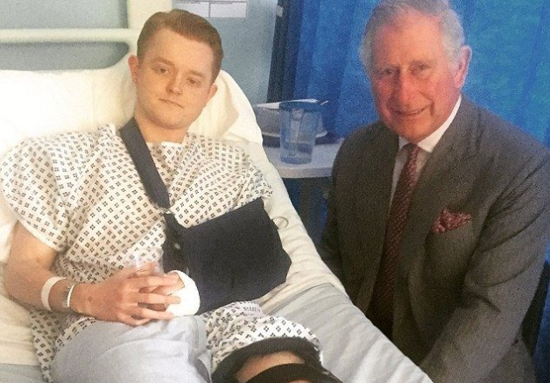
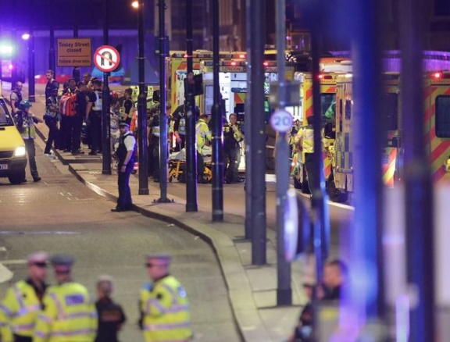


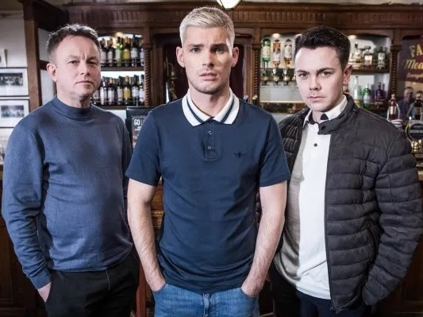
2
Why are we talking about this?
For this topic we have teamed up with the Counter Terrorism Police to discuss whether sharing stories can help prevent extremism. You are going to hear a range of powerful accounts from people whose lives have been changed by extremism and find out how the issue has been tackled by TV shows such as Hollyoaks.
The people you are going to hear from have shared their stories to raise awareness and improve our understanding of the real effects extremism can have.
However, it is important to remember that extreme groups also use stories to persuade people to become part of their organisation.
Notes:
References
https://www.ltai.info/
Images
https://www.standard.co.uk/news/london/westminster-survivor-describes-being-thrown-like-a-rag-doll-over-khalid-masoods-car-a3517336.html
https://www.pinterest.co.uk/pin/104075441370483785/?lp=true
https://www.standard.co.uk/news/london/families-of-westminster-attack-victims-demand-end-to-online-extremism-a3740341.html
https://i2-prod.mirror.co.uk/incoming/article12638965.ece/ALTERNATES/s615b/EMB-Incident-at-London-Bridge.jpg
https://metro.co.uk/2019/09/20/hollyoaks-deserves-praise-gets-tackling-far-right-extremism-uk-10778280/

Slide 7
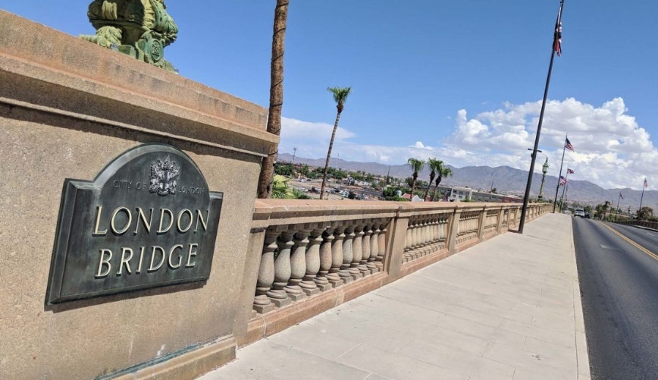

3
Real-life consequences
On 3 June 2017, a van was deliberately driven into pedestrians on London Bridge. The attackers crashed the van then ran to the nearby Borough Market area and began attacking people. The attackers were inspired by Islamic State (ISIS).
“The people who did this are just human beings like you and me.”
0:00 -1:31
Thomas* witnessed a family member being hit by the car on London Bridge.
Pair task (3-4 mins)
Watch and discuss your thoughts on Thomas’ story. What message is he trying to give about the attackers? Do you agree?
No one is born a terrorist.”
Challenge:
How could a situation like Thomas’ push someone towards extremist views?
https://safeshare.tv/x/ss5dc5435358d3a
Notes:
*Name changed to protect the privacy of the speaker.
Alternative video link: https://www.youtube.com/watch?v=a9I56Yr__MI
Alternative link:
References:
1) https://en.wikipedia.org/wiki/2017_London_Bridge_attack
Images:
https://www.pinterest.co.uk/pin/104075441370483785/?lp=true
https://i2-prod.mirror.co.uk/incoming/article12638965.ece/ALTERNATES/s615b/EMB-Incident-at-London-Bridge.jpg

Slide 8
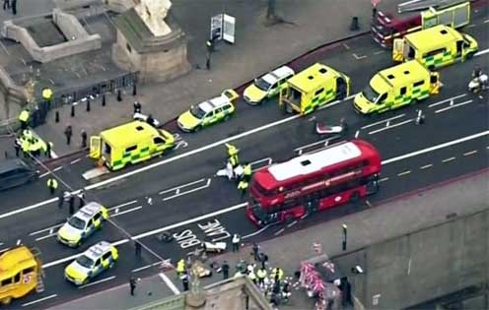
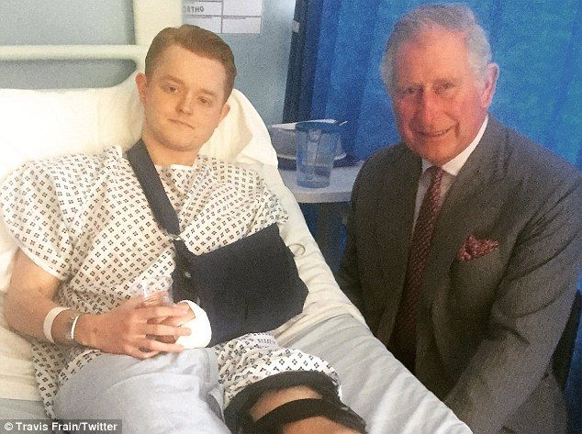
3
Real-life consequences
On 22nd March 2017, a terrorist attack took place on Westminster Bridge. The attacker drove a car onto the pavement and injured more than 50 people. Five people died.
0:00 -1:22
Video task (3-4 mins)
Watch and discuss your thoughts on Travis’ story. How could someone speaking up have changed Travis’ story?
Travis was one of the people injured that day.
Challenge:
How might extremists use this story to benefit their cause?
https://safeshare.tv/x/CQsnabyOwyc
Notes:
Alternative link: https://www.youtube.com/watch?v=CQsnabyOwyc
Images:
iStock
https://www.pinterest.co.uk/pin/104075441370483785/?lp=true

Slide 9






4
The other side of the story
Pair task (4-6 mins)
What are these statements trying to make you feel?
Extremist groups often tell stories which are personalised to make the listeners feel certain emotions. The stories may be based on true events, exaggerated or completely made up.
“It’s time to get revenge for what they’ve done to us.”
“Life will be better without them.”
“We need people like you.”
“No one is listening, we have to take action.”
“We have to defend ourselves.”
“They are to blame.”
“We know how you feel.”
Angry
Afraid
Victimised
Proud
Hopeful
Valued
Notes:
Images:
https://emojipedia.org/apple/

Slide 10

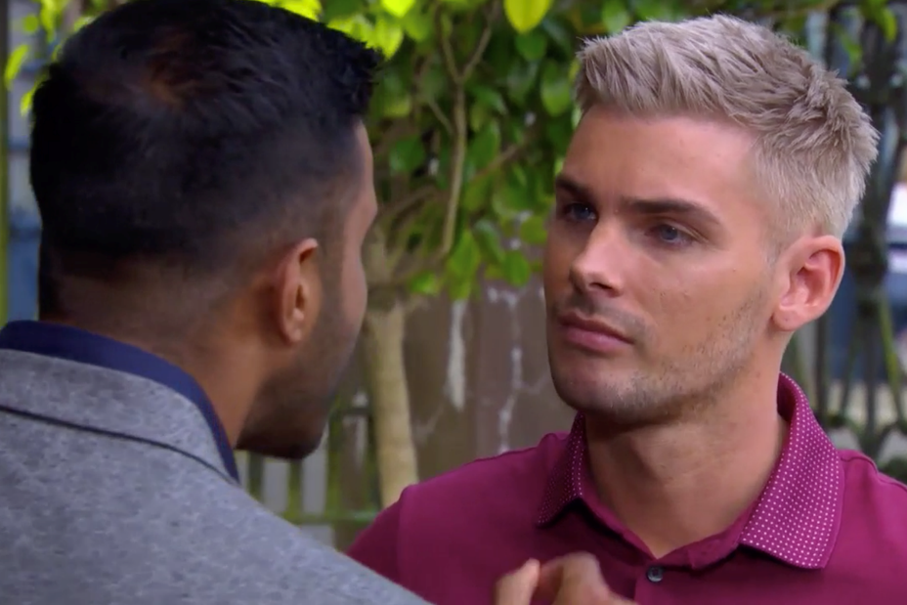
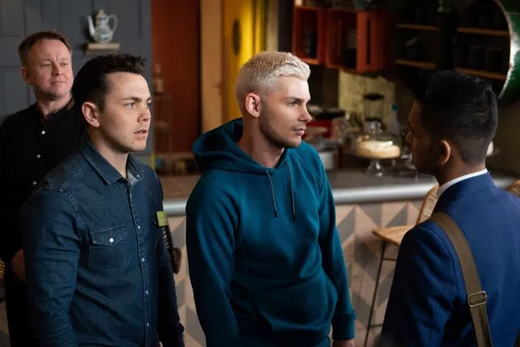
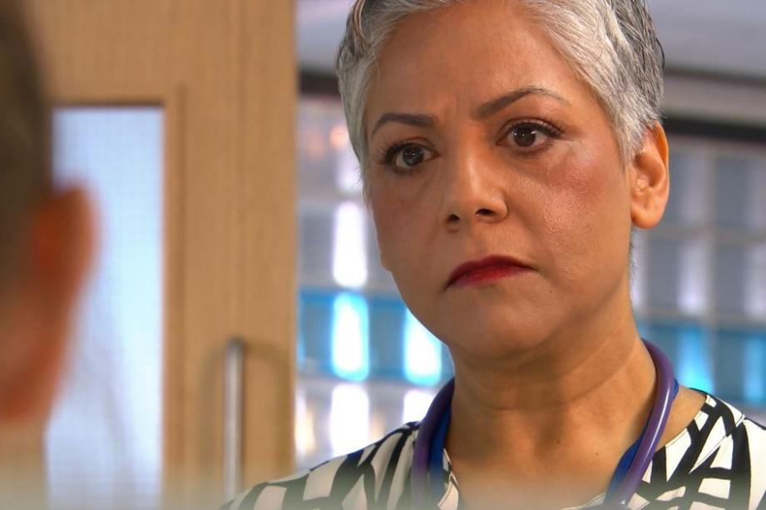
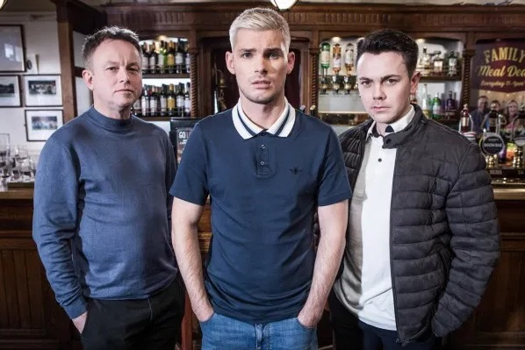
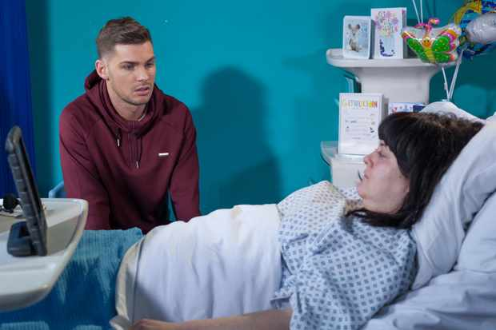
4
The other side of the story
Hollyoaks draw attention to extremism in Ste’s storyline…
Ste’s sister died in a terrible accident, which left him upset and angry.
He blamed the doctor, Misbah, for her death because thought she had made a mistake when caring for his sister.
Members of an extreme group, Jonny and Stuart, recognised that Ste was vulnerable and gained his trust.
They told Ste that people like Misbah should be blamed for most of his problems because they are Muslim. They tried to persuade him to damage a local centre that many Muslims use.
Hollyoaks wanted to portray how extremism and radicalisation can happen to anyone and show what you can do if you’re worried that yourself or someone you know is being radicalised.
After some encouragement from his family, Ste agrees to talk to a Prevent officer who is helping Ste break his ties with the extremist group.
Radicalise
Making someone become more extreme in their beliefs.
Notes:
References:
https://www.digitalspy.com/soaps/hollyoaks/a29726264/hollyoaks-spoilers-ste-hay-escape-mercedes-suspects/
https://dictionary.cambridge.org/dictionary/english/radicalize?q=radicalise
Images:
https://www.radiotimes.com/news/2018-03-27/hollyoaks-tegan-is-awake-will-she-tell-ste-the-truth-about-ryan/
https://www.mirror.co.uk/tv/tv-news/hollyoaks-shock-misbah-maalik-decides-11827951
https://metro.co.uk/2019/06/13/hollyoaks-spoilers-ste-hay-discovers-the-shocking-truth-about-racist-jonny-baxter-9949481/
https://metro.co.uk/2019/05/02/hollyoaks-spoilers-ste-makes-a-shocking-decision-after-leela-tackles-racist-jonny-9394596/
https://www.facebook.com/permalink.php?id=351853981687338&story_fbid=1023822891157107

Slide 11

4
The other side of the story
Around the UK, there are various far-right extremist groups that continue to have active members. Organisation like National Action and the English Defence League (EDL) have been repeatedly accused of creating tensions between Muslim and non-Muslim communities².
0:00 – 4:05
Like Ste in Hollyoaks, John was radicalised by a far-right group.
Video task (5-7 mins)
Listen and discuss your thoughts on John’s story. What stories was he told which lead him to join the group?
Challenge:
Why do the hollyoaks cast think it’s important to tell this story?
https://safeshare.tv/x/ss5dcc3a6c45a53
Notes:
Alternative video link https://www.youtube.com/watch?v=h3dhvmPEqwE (0:00-4:05)
*Name changed to protect the privacy of the speaker.
Alternative link:
References
Definition paraphrased from EDL Mission Summary
Jackson, Paul (2011). The EDL: Britain's 'New Far Right' Social Movement (Report). Northampton: University of Northampton
Busher, Joel (2018). "Why Even Misleading Identity Claims Matter: The Evolution of the English Defence League". Political Studies. 66 (2). pp. 323–338
Images
https://www.manchester.ac.uk/discover/news/book-provides-rare-glimpse-inside-the-english-defence-league/

Slide 12



5
Why share these stories?
“This is my story, but there’s another side to this.”
““They’re just very angry people who are using the far right as a way to vent their anger.”
Class discussion (3-5 mins)
Why do you think these people have decided to share their stories with you? What are they trying to achieve/avoid?
“No one is born a terrorist.”
Challenge:
How might extremists use these stories to benefit their cause?
Notes:
Images
https://www.pinterest.co.uk/pin/104075441370483785/?lp=true
https://www.manchester.ac.uk/discover/news/book-provides-rare-glimpse-inside-the-english-defence-league/
https://time.com/3281925/somalia-al-shabab/
https://i2-prod.mirror.co.uk/incoming/article12638965.ece/ALTERNATES/s615b/EMB-Incident-at-London-Bridge.jpg

Slide 13
5
Why share these stories?
0:00 -5:35
Video task (7-10 mins)
Watch the rest of the video on John, Hollyoaks and Prevent. How can talking to organisations like Prevent help people in John or Ste’s position?
https://safeshare.tv/x/ss5dcc3cf735f43
Notes:
Alternative video link https://www.youtube.com/watch?v=h3dhvmPEqwE (4:07-end)
Images
https://www.pinterest.co.uk/pin/104075441370483785/?lp=true
https://www.manchester.ac.uk/discover/news/book-provides-rare-glimpse-inside-the-english-defence-league/
https://time.com/3281925/somalia-al-shabab/
https://i2-prod.mirror.co.uk/incoming/article12638965.ece/ALTERNATES/s615b/EMB-Incident-at-London-Bridge.jpg

Slide 14


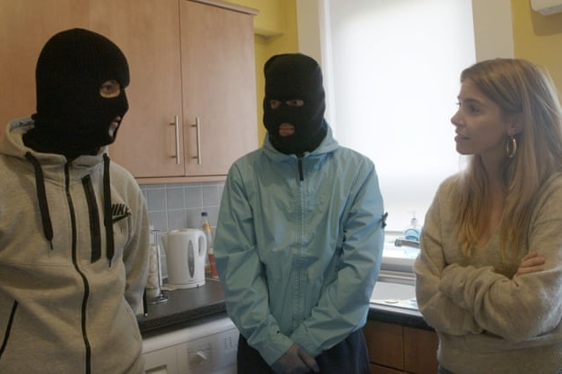
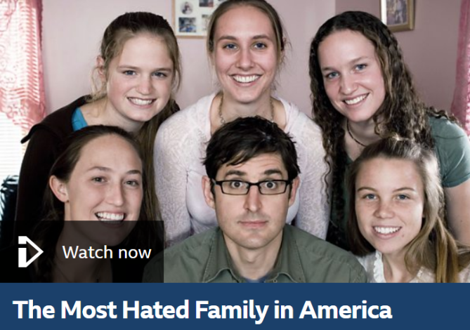

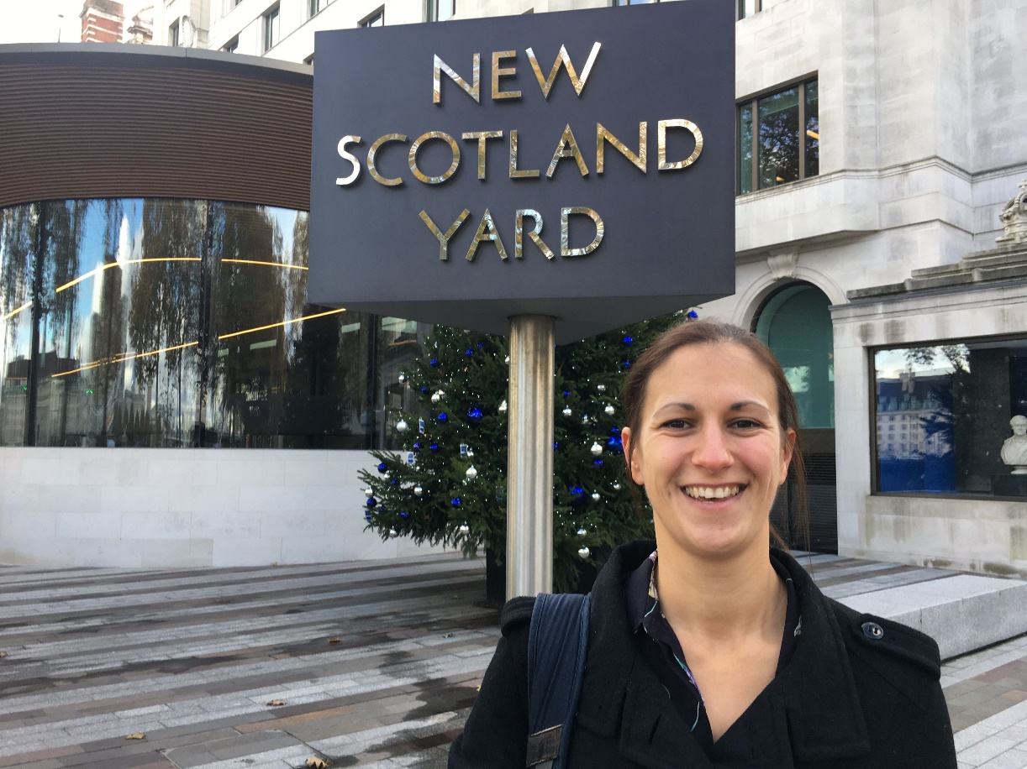
Career Launchpad!
Learn more: Extreme TV
There have been a host of insightful documentaries made on extremism. Click the pictures to check some of them out, including work from Vice, Stacey Dooley and Louis Theroux.
Warning: some of these may contain upsetting content or offensive language.
00:00-03:04
Career Spotlight:
Lou works for the Counter Terrorism Police.
Click the image to watch a video made especially for you by Lou explaining what her day-to-day job entails and what drew her to joining the police.
Notes:
Alternative Video Link: https://www.youtube.com/watch?v=hfOPunAidUQ&t=4s
Images
https://www.viceland.com/en_us/show/hate-thy-neighbour
https://www.theguardian.com/tv-and-radio/2017/aug/13/stacey-dooley-investigates-bbc3-interview
https://www.bbc.co.uk/programmes/b007clvf
References
https://www.channel4.com/programmes/hate-thy-neighbour
https://www.dailymotion.com/video/x3cjs5v
https://www.bbc.co.uk/programmes/b007clvf

Slide 15


Can sharing stories keep us safe?
We can learn from other people’s experiences and keep ourselves safe.
Stories are more memorable than statistics or information, which helps us remember the message.
Stories have always been used to teach us lessons. They help us learn.
Many people our age are more likely to watch shows like Hollyoaks then listen to the news, so these stories can make more of a difference.
People can lie in stories and teach us the wrong thing.
Extremist groups also use stories to manipulate people into joining them.
While stories might help promote understanding and reduce extreme views, actions bring about change, not talking.
Stories can only get us so far; we need people like the police to keep us safe.

Slide 16

PRINT ME
Need more information or someone to talk to?
Students | Teachers | Other useful links
Remember, you can always talk to a trusted adult, like a teacher or a family member, if you are at all worried about anything. | If you need to talk to someone about the concerns you have for a child, call the NSPCC helpline on 0808 800 5000. They are open 24/7. | To report any online material you think promotes extremism or terrorism, go to: https://www.report-terrorist-material.homeoffice.gov.uk/report
Visit the ‘Let’s Talk About It’ website, a guide which gives practical help and guidance on what to do if you think someone might be being radicalised. https://www.ltai.info/ | NSPCC gives advice for adults worried about a child becoming radicalised. | NSPCC launched a free 24 hour helpline on 0808 800 5000 for anyone worried about radicalisation and the impact of terrorism. They have access to trained counsellors.
If you need to talk to someone and you’re not sure who to go to, call Childline, a confidential helpline for children, on 0800 1111 – they are open 24/7 (all the time!) www.childline.org.uk | DfE website Educate Against Hate gives teachers, parents and school leaders practical advice and information on protecting children from extremism and radicalisation. https://educateagainsthate.com/ | To report suspicious activity to the police, you can either call them in confidence on 0800 789 321, or complete this online secure reporting form at: https://act.campaign.gov.uk/ If it’s an emergency call 999.
 | Family Lives offer advice for professionals and parents if they are worried about a child being radicalised. | Families Against Stress and Trauma (FAST), provide support to vulnerable families and individuals whose lives have been affected by the trauma of losing loved ones to hateful ideologies and groups.

