Slide 1
Equality, Diversity & Inclusion
For Academy Players (U9-U11)
Notes:
Today we are going to talk about Equality, Diversity and Inclusion, which our Club takes very seriously.
CLICK TO START PRESENTATION

Slide 2
What is Equality, Diversity & Inclusion?
Equality
Diversity
Inclusion
Everyone has access to the same football boot
Everyone has access to football boots, but they can be different
The football boots can touch the ball
Notes:
ASK QUESTION TO PLAYERS: Can anyone tell me what Equality, Diversity and Inclusion mean?
CLICK: Equality is like everyone having the same football boots, the same size, the same colour and the same brand.
ASK QUESTION TO PLAYERS: Does anyone see a problem with this? What happens if you are given a size 8 football boots when you are a size 3 (Players may say that not everyone has the same size feet or like the same colour)
CLICK: Diversity is giving everyone the football boots they need – Giving the correct size, letter them choose the colour and the brand they want.
Doing this allows everyone to have the best opportunity to do their best because they are provided the correct support
CLICK: Inclusion is being provided the boots you need and then being able to play with ball.
CLICK TO NEXT SLIDE

Slide 3
What is Equality, Diversity & Inclusion?
Equality
Diversity
Inclusion
9
9
1
9
1
9
3
3
9
9
6
6
9
8
8
9
Everyone has the same #9 shirt & play striker
Players can play in different positions due to their skills
Working together as a team
Notes:
Lets look at another explanation
CLICK: Equality is everyone being given the number 9 shirt to play in.
ASK QUESTION TO PLAYERS: Does anyone see an issue with this? (Players may say that not everyone can play in the same position)
CLICK: Having a full team of strikers wouldn’t make an effective team – we probably wouldn’t win the game.
CLICK: Diversity is having a team of players who play different positions, this can be based on the skills and strengths
CLICK: Inclusion is working together using all the players as a team
CLICK TO NEXT SLIDE

Slide 4
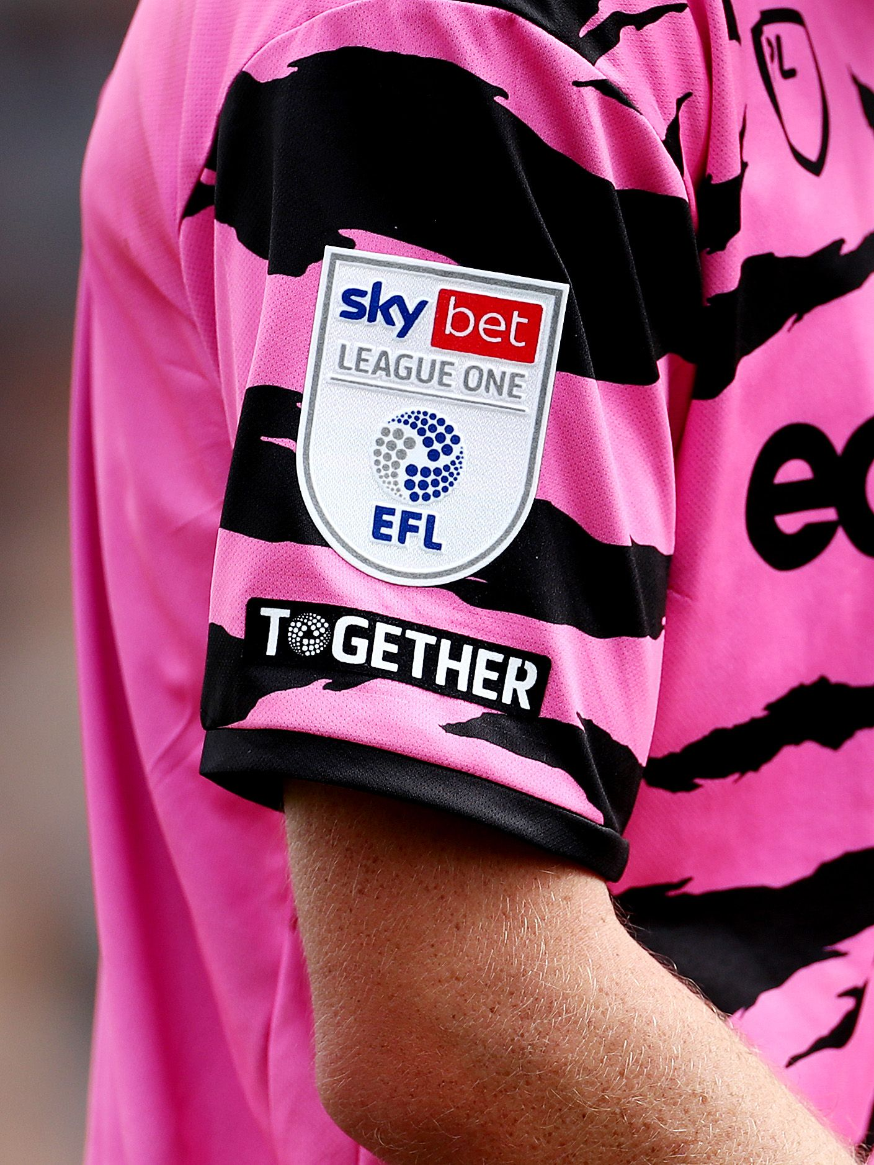
What Does Together Mean To You?
Notes:
CLICK: The EFL has a campaign for Equality, Diversity and Inclusion called “Together” which is seen on social media and on the shirt sleeves of every EFL Shirt.
ASK QUESTION TO PLAYERS: What does Together mean to you
CLICK TO NEXT SLIDE

Slide 5
What can you do?
Talk & Ask Questions
Be Together /
Do Not Exclude
Be A Good Person
Notes:
As a team, lets consider what we can do to support Equality, Diversity and Inclusion
CLICK: First we can ask questions of our teammates and talk to each other. We all have differences, this might be the school we go to, our preferred foot, our race, our religion and even why we play our favourite position on the pitch. It is ok to ask questions about our teammates.
Secondly we should be together and not exclude teammates. We work better together. That is why we train together, why we warm up together and do things as a team.
Finally, this one is simple, we should be a good person. We have good manners, we say hello, goodbye, please, thank you, we pick up our water bottles after games and training, we help collect all the kit, we are respectful to each other
CLICK TO NEXT SLIDE

Slide 6
Notes:
If we need or want to speak to someone about Equality, Diversity and Inclusion please contact
INSERT DETAILS OF CLUB CONTACT

