Slide 1
Equality, Diversity & Inclusion
For Academy Players (U12-U21)
Notes:
Today we are going to talk about Equality, Diversity and Inclusion, which our Club takes very seriously.
CLICK TO START PRESENTATION

Slide 2
What is Equality, Diversity & Inclusion?
Notes:
CLICK PLAY TO START VIDEO
CLICK TO NEXT SLIDE

Slide 3
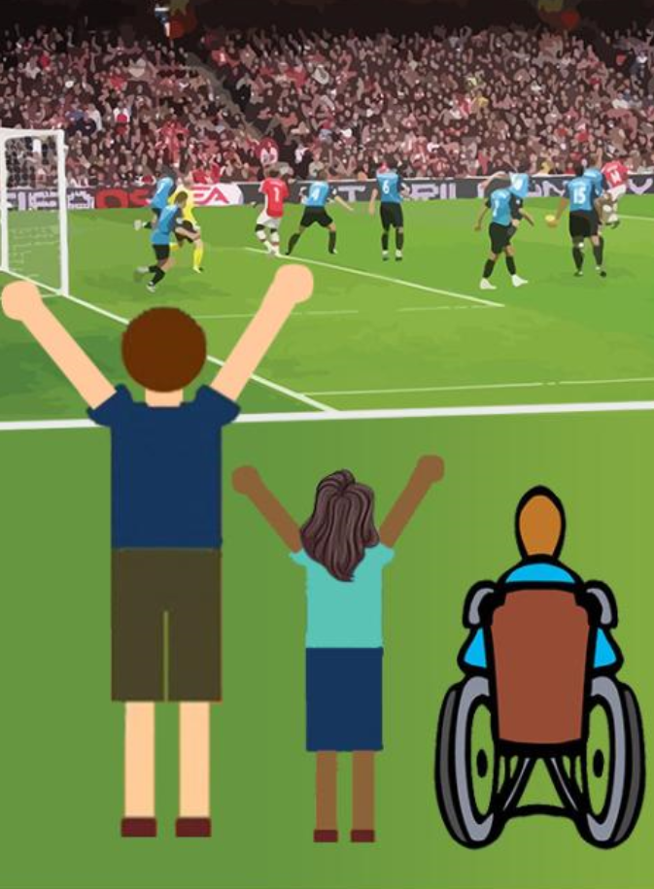
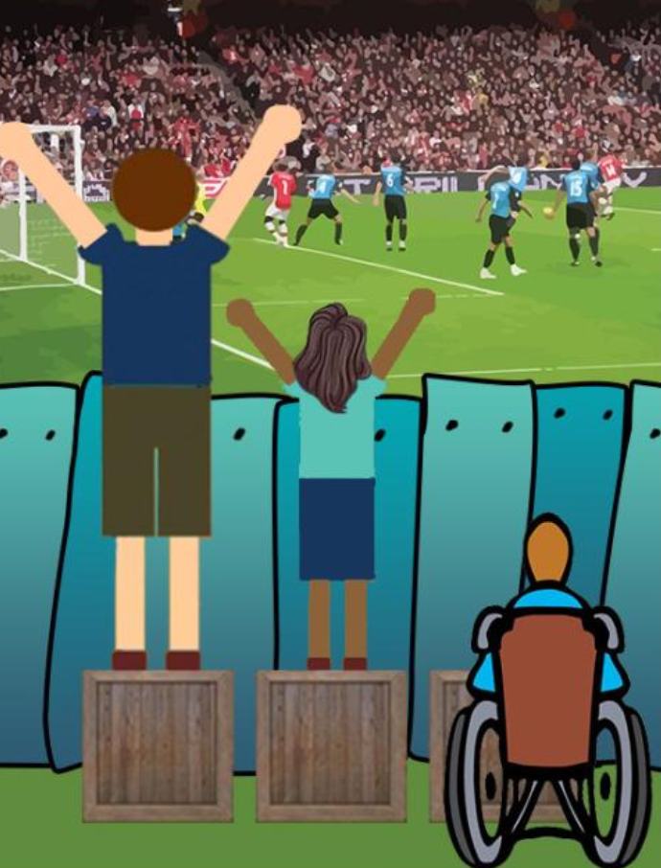
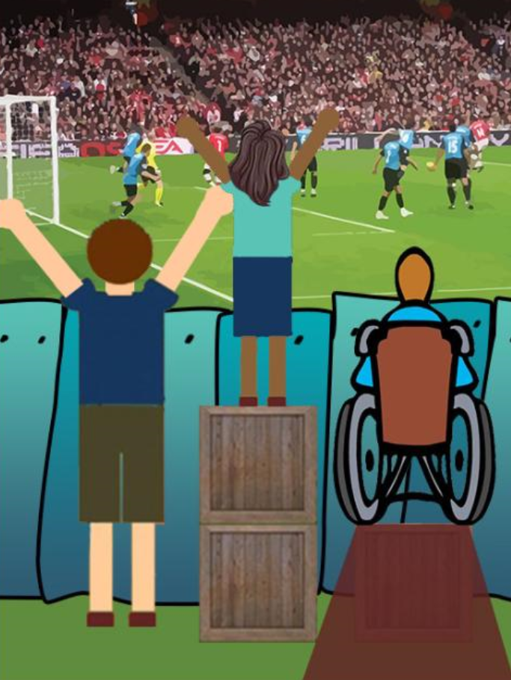
Equality Diversity & Inclusion - Simple Explanation
Notes:
Equality, Diversity and Inclusion can be explained in many different ways.
CLICK: Many people would explain the Equality, Diversity and Inclusion means that you give everyone the same opportunity. If you do this then you are being fair.
CLICK: This explanation is not ideal, Equality, Diversity and Inclusion is better explained by giving every same opportunity, but the same opportunity succeed. This means maybe giving someone more support to see over the fence. If we look at this example there is not point giving the wheelchair user a box to see over the fence. The box requires to be deconstructed and made into a ramp for them to use it. In a football terms its like having a goalkeeper but not giving them goalkeeper drills, or having strikers but never practicing shooting.
CLICK: Overall across society we want to move the barriers completely that means that everyone can achieve.
CLICK TO NEXT SLIDE

Slide 4
Protected Characteristics
How Does Football Alter?
Rules to Participate
Sex
Religion & Belief
Pregnancy & Maternity
Need to Consider
Gender Reassignment
Marriage & Civil Partnership
Race
No Change to Game
Sexual Orientation
Disability
Age
Notes:
Equality, Diversity and Inclusion focuses on 9 characteristics which are protected under the law.
CLICK: These are Religion & Belief, Sex (Gender), Pregnancy and Maternity, Gender Reassignment, Marriage & Civil Partnership, Race, Disability, Age and Sexual Orientation. The law states that normally you are not allowed to treat someone different due to any of the characteristics
CLICK: Football in certain aspects requires to treat the charactistics differently.
QUESTION TO PLAYERS: What characteristics do the rules need to change to accommodate, which ones do we need to consider the charactistics to allow people to play and which ones is there no need to change the game?
COACH
Religion and Belief: No need to change the rules normally. We might offer a stoppage during the game for Muslim players during the holy month of Ramadan.
Gender Reassignment: If a player chooses to game their gender, then they require to undertake FA rules to be able to play
Disability: If a player has a disability then we need to consider the best way to support playing the game. A deaf player can play mainstream football, but they can also play deaf football. However a powerchair footballers can only play powerchair football. We need to consider the needs to allow them to succeed.
Sex (Gender): We have men's and women's football
Marriage and Civil Partnership: Does not matter to play football
Age: We have different age groups within youth football
Pregnancy: We need to consider participation, most pregnant people will stop playing as soon as they know they are pregnant, however they could still train
Race: Does not matter to play football
Sexual Orientation: Does not matter to play football
CLICK TO NEXT SLIDE

Slide 5
Intersectionality
Religion & Belief
Sex
Pregnancy & Maternity
Gender Reassignment
Marriage & Civil Partnership
Race
Sexual Orientation
Disability
Age
Notes:
People are defined by not just one characteristic and they will cover a number of different characteristics and this means they have a number of different aspects we need to consider and think about.
CLICK: This is called Intersectionality
CLICK: For example someone might be Muslim (Religion), with a South Asian background (Race) but also require the use of a wheelchair (Disability)
CLCIK TO NEXT SLIDE

Slide 6
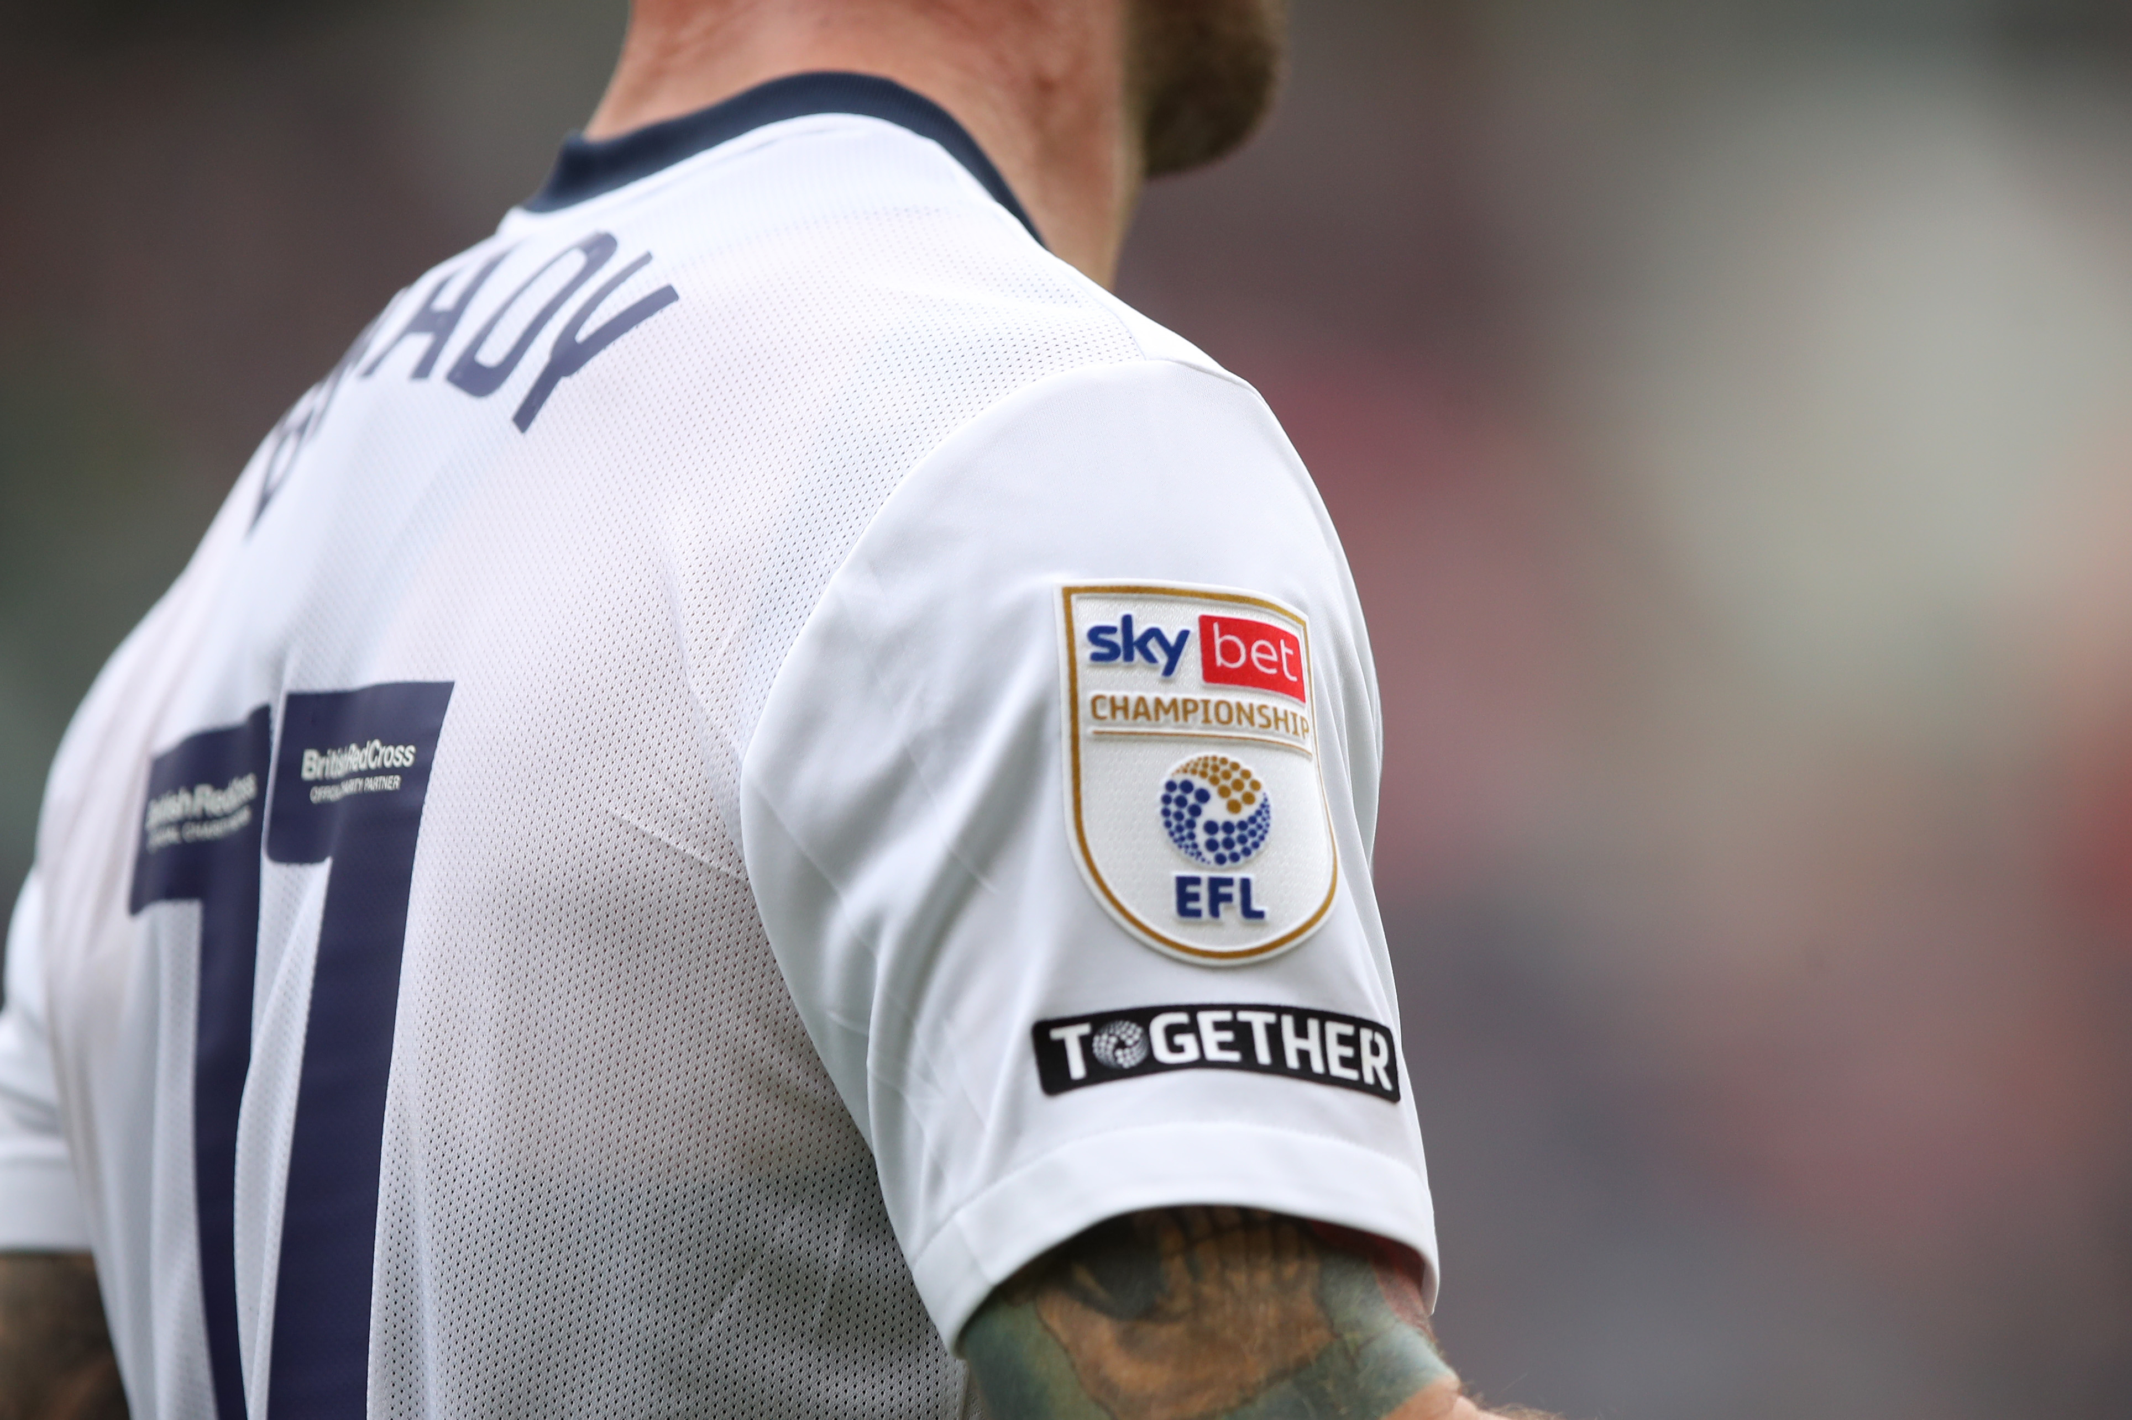
What Does Together Mean To You?
Notes:
CLICK: The EFL has a campaign for Equality, Diversity and Inclusion called “Together” which is seen on social media and on the shirt sleeves of every EFL Shirt.
ASK QUESTION TO PLAYERS: What does Together mean to you
CLICK TO NEXT SLIDE

Slide 7
What can you do?
Talk & Ask Questions
Be Together /
Do Not Exclude
Be A Good Person
Challenge Poor Behaviour
Be A Role Model
Notes:
As a team, lets consider what we can do promote Equality, Diversity and Inclusion.
CLICK: we can ask questions of our teammates and talk to each other. We all have differences, this might be the school we go to, our preferred foot, our race, our religion and even why we play our favourite position on the pitch. It is ok to ask questions about our teammates.
We should be together and not exclude teammates. We work better together. That is why we train together, why we warm up together and do things as a team.
This one is simple, we should be a good person. We have good manners, we say hello, goodbye, please, thank you, we pick up our water bottles after games and training, we help collect all the kit, we are respectful to each other
If we see poor behaviour from teammates or other we should challenge it.
We can be a role model and Include our team mates and be the top three
CLICK TO NEXT SLIDE

Slide 8
Notes:
If we need or want to speak to someone about Equality, Diversity and Inclusion please contact
INSERT DETAILS OF CLUB CONTACT

